Slide 1
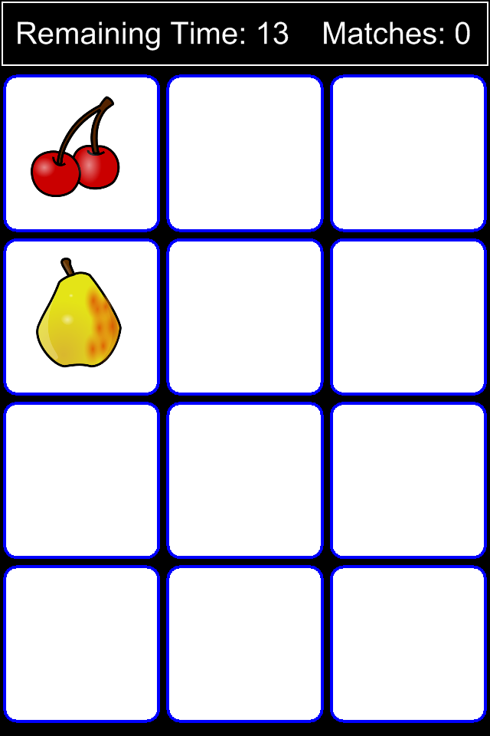
Memory Flipper

Slide 2
Summary
Game Goal: Within a fixed period (timed) locate every pair of matching cards, remember where they are, and click on them in sequence to remove them from the board.
Game Attributes:
  The 'game board' is comprised of an even number of 'cards' distributed 'face down' in an N x M grid.
  Every card has a hidden image.
  Every image is used twice.
  Tapping A Card Flips It
  After two cards have been tapped, their images are 'compared'.
    If they match, they are removed from the board and a point is awarded.
    If they do not match, they are flipped over again.
  Play time is limited by a countdown timer.

Slide 3
Topics We Will Examine
(not necessarily in listed order)
Transitions and Timers
Attaching Functions and Methods to objects
Card 'Flipping' Visual Effects
Card Matching Logic
Grid Layout and Spacing Tips
Touch Inputs
SSK Globals and Helper Functions
SSK Quick Layers
Events / Messaging
(re-) Use of Modules
Adding Interfaces with Composer (Scene Library)

Slide 4
Interfaces Inventory
Splash
Main Menu
Play GUI
Win Overlay
Lose Overlay
Options

Slide 5
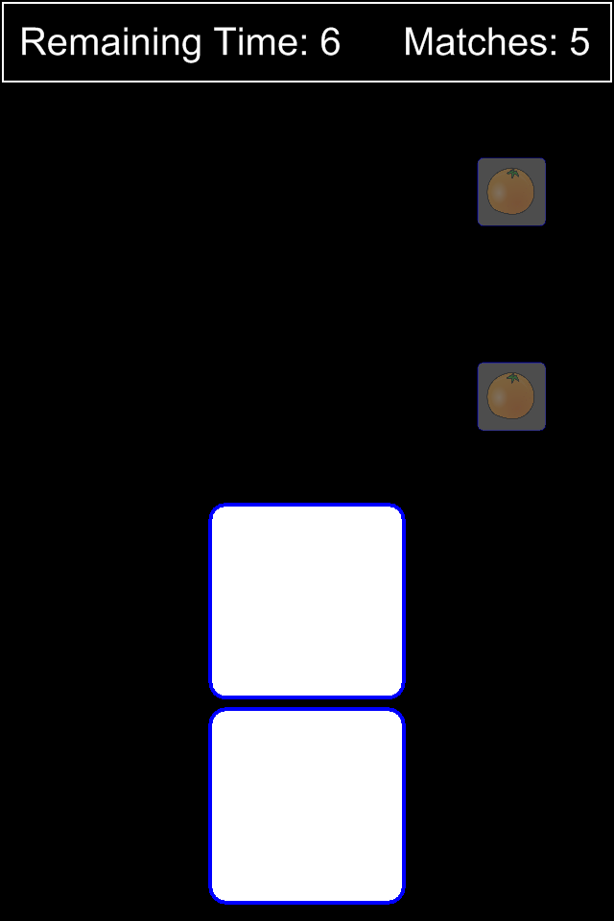
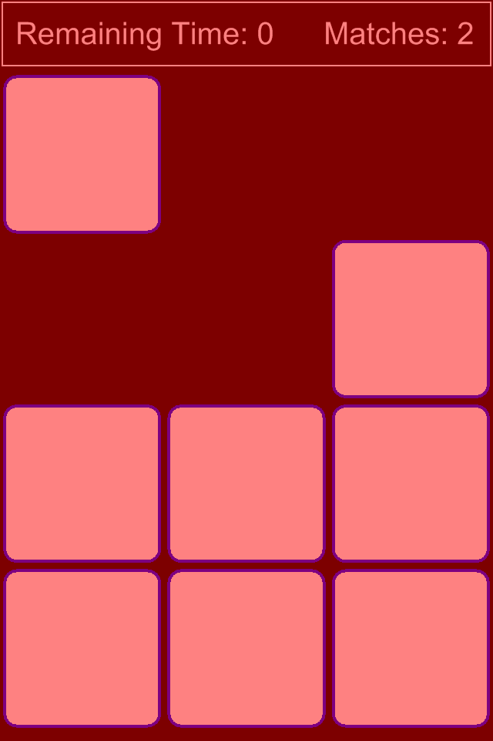
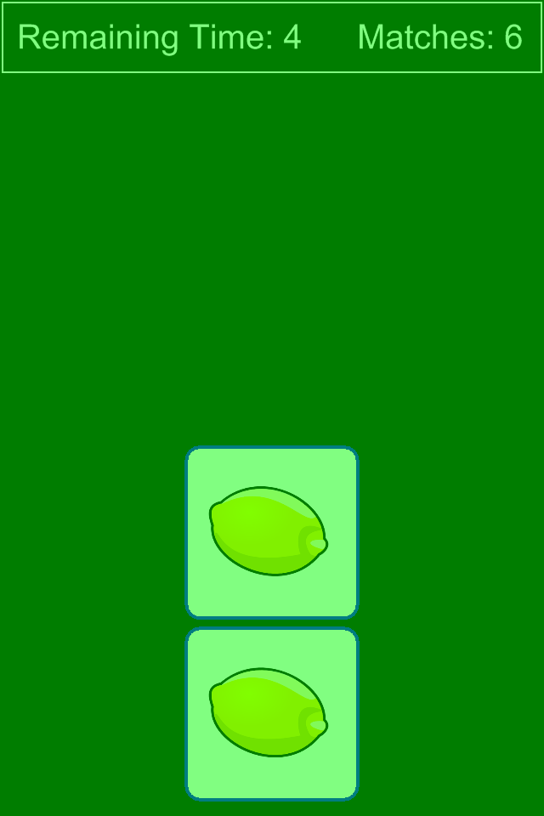
Sample Screens

